Slide 1
Writing Letters

Slide 2
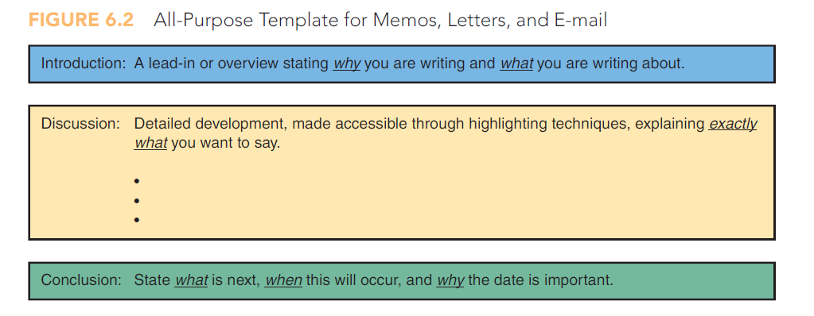

Slide 3
Letters Vs. Emails
Emails might be too quick and hence neglectfully drafted.
Emails are casual and conversational whereas letters allow for a more formal correspondence.
Letters can allow for more detail.
Letters carry more significance.
Letters allow greater paper trail.

Slide 4

Letters

Slide 5
Letters
Essential components of Letter:
Typed or printed
Business-like font
Writer’s address
Date
Reader’s address
Salutation
Letter text
Complimentary close
Signed name
Typed name

Slide 6
Letters
8 ½” * 11” paper
1” to 1 ½” margins top + sides
Essential components of Letter:
Typed or printed
Business-like font
Writer’s address
Date
Reader’s address
Salutation
Letter text
Complimentary close
Signed name
Typed name

Slide 7
Letters
Size and style:
Times New Roman or Arial (12pts)
*Avoid designer fonts
Essential components of Letter:
Typed or printed
Business-like font
Writer’s address
Date
Reader’s address
Salutation
Letter text
Complimentary close
Signed name
Typed name

Slide 8
Letters
Tailored according the letterhead paper or absence of it
Essential components of Letter:
Typed or printed
Business-like font
Writer’s address
Date
Reader’s address
Salutation
Letter text
Complimentary close
Signed name
Typed name

Slide 9
Letters
Address includes street address, city, country
Essential components of Letter:
Typed or printed
Business-like font
Writer’s address
Date
Reader’s address
Salutation
Letter text
Complimentary close
Signed name
Typed name

Slide 10
Letters
Follow the conventions of date in your area
May 31, 2014
31 May 2014
Essential components of Letter:
Typed or printed
Business-like font
Writer’s address
Date
Reader’s address
Salutation
Letter text
Complimentary close
Signed name
Typed name

Slide 11
Letters
Follows date with two line spacing
Name
Title (if any)
Company name
Street address
City
Essential components of Letter:
Typed or printed
Business-like font
Writer’s address
Date
Reader’s address
Salutation
Letter text
Complimentary close
Signed name
Typed name

Slide 12
Letters
Two line spacing
Dear [reader’s name:]
If unfamiliar with marital status of a woman, use Ms.
Essential components of Letter:
Typed or printed
Business-like font
Writer’s address
Date
Reader’s address
Salutation
Letter text
Complimentary close
Signed name
Typed name

Slide 13
Letters
Two line spacing
Introductory paragraph
Discussion paragraph
Concluding paragraph
*Single spaced with double spacing between paragraphs
Essential components of Letter:
Typed or printed
Business-like font
Writer’s address
Date
Reader’s address
Salutation
Letter text
Complimentary close
Signed name
Typed name

Slide 14
Letters
Two spacing
[Complimentary close],
Ex: Sincerely, Yours Truly, Sincerely Yours
Essential components of Letter:
Typed or printed
Business-like font
Writer’s address
Date
Reader’s address
Salutation
Letter text
Complimentary close
Signed name
Typed name

Slide 15
Letters
Legibly sign
Electronic (digital) signature
Essential components of Letter:
Typed or printed
Business-like font
Writer’s address
Date
Reader’s address
Salutation
Letter text
Complimentary close
Signed name
Typed name

Slide 16
Letters
Place it four spaces below complimentary close
Title one space beneath typed name
OR
Typed name, Title
Essential components of Letter:
Typed or printed
Business-like font
Writer’s address
Date
Reader’s address
Salutation
Letter text
Complimentary close
Signed name
Typed name

Slide 17
Optional Components of Letters
Helps reader understand letter intent
Serves as a replacement for salutation
Subject Line
Letter’s intent
New Page Notation
For letters longer than one page
Changes in simplified format
Placement
Pretext for another page
Formatting
Writer’s and Typist’s Initials
Formatting
Not necessary sometimes

Slide 18
Optional Components of Letters
Two spaces below reader’s address and two spaces above the salutation
Subject Line
Letter’s intent
New Page Notation
For letters longer than one page
Changes in simplified format
Placement
Pretext for another page
Formatting
Writer’s and Typist’s Initials
Formatting
Not necessary sometimes

Slide 19
Optional Components of Letters
In simplified format subject line is added and both salutation and complimentary close are omitted.
Subject Line
Letter’s intent
New Page Notation
For letters longer than one page
In simplified format
Placement
Pretext for another page
Formatting
Writer’s and Typist’s Initials
Formatting
Not necessary sometimes

Slide 20
Optional Components of Letters
Either
Flush with the left margin at the top of subsequent pages
Across top of subsequent pages
Subject Line
Letter’s intent
New Page Notation
For letters longer than one page
In simplified format
Placement
Pretext for another page
Formatting
Writer’s and Typist’s Initials
Formatting
Not necessary sometimes

Slide 21

Optional Components of Letters
Subject Line
Letter’s intent
New Page Notation
For letters longer than one page
In simplified format
Placement
Pretext for another page
Formatting
Writer’s and Typist’s Initials
Formatting
Not necessary sometimes

Slide 22
Optional Components of Letters
Only required if you have at least two lines of text on the next page to justify another page
Subject Line
Letter’s intent
New Page Notation
For letters longer than one page
In simplified format
Placement
Pretext for another page
Formatting
Writer’s and Typist’s Initials
Formatting
Not necessary sometimes

Slide 23

Optional Components of Letters
Subject Line
Letter’s intent
New Page Notation
For letters longer than one page
In simplified format
Placement
Pretext for another page
Formatting
Writer’s and Typist’s Initials
Formatting
Not necessary sometimes

Slide 24
Optional Components of Letters
Not necessary if the writer and the typist are the same
Subject Line
Letter’s intent
New Page Notation
For letters longer than one page
In simplified format
Placement
Pretext for another page
Formatting
Writer’s and Typist’s Initials
Formatting
Not necessary sometimes

Slide 25
Optional Components of Letters
Invoice or reports relevant to the contents of a letter
Enclosure Notation
Additional documents
Copy Notation
Enclosure notation
Placement
Copy to other readers
Formatting
Placement

Slide 26
Optional Components of Letters
Mention this enclosure by typing either Enc. Or Enclosure followed by a colon (:)
Specify if multiple items are enclosed
OR
What has been enclosed
Enclosure Notation
Additional documents
Copy Notation
Enclosure notation
Placement
Copy to other readers
Formatting
Placement

Slide 27
Optional Components of Letters
Place it two spaces below the typed signature
Enclosure Notation
Additional documents
Copy Notation
Enclosure notation
Placement
Copy to other readers
Formatting
Placement

Slide 28
Optional Components of Letters
If the letter copy is shared with other readers, indicate it with copy notation
Enclosure Notation
Additional documents
Copy Notation
Enclosure notation
Placement
Copy to other readers
Formatting
Placement

Slide 29
Optional Components of Letters
Designated by a lowercase “cc”
Enclosure Notation
Additional documents
Copy Notation
Enclosure notation
Placement
Copy to other readers
Formatting
Placement

Slide 30
Optional Components of Letters
Two spaces below the typed signature or below the writer’s and typist’s initials
Enclosure Notation
Additional documents
Copy Notation
Enclosure notation
Placement
Copy to other readers
Formatting
Placement

Slide 31
Optional Components of Letters
Two spaces below the typed signature or below the writer’s and typist’s initials
Enclosure Notation
Additional documents
Copy Notation
Enclosure notation
Placement
Copy to other readers
Formatting
Placement

Slide 32
Formatting Letters
Omit salutation if you do not know reader’s name
Writing to a non-gender-specific name
*if you omit it, also omit complimentary close
Full block/Full block with subject line
Simplified format
All information flush left margin
Full block with subject line differs only with the inclusion of subject line
All text is typed margin left
No salutation
No complimentary close
Includes a subject line

Slide 33
Criteria for Different Routine Correspondence
Inquiry
Response
Complaint
Cover
Adjustment
Confirmation

Slide 34
Inquiry
Information about degree requirements, equipment costs, performance records, turnaround time, employee credentials or other matters of interests
Demands specificity

Slide 35
Inquiry
Introduction clarifies intent and rationale
The subject matter of inquiry
Discussion asks precise questions of quantifiable list of specific topics of inquiry
Conclusion includes dated action/response and the significance of the date.

Slide 36
Response: Inquiry
Add these components to discussion:
time, dates, amounts of people, types of activities, discounts, costs, enrollment periods, enclosures, technology or equipment
Provide information, details or answers to inquiry
In introduction, pleasant reminder of last communication. This explains why you are writing to them.
Organize into as many paragraphs as you need (or bulleted or numbered lists)
Conclusion has upbeat and friendly tone and contact information.

Slide 37
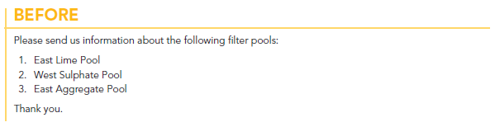
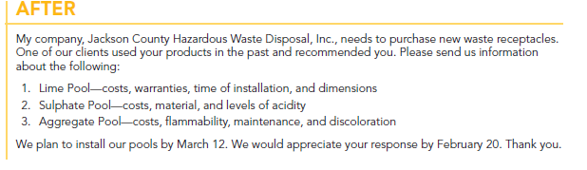

Slide 38
Cover (Transmittal)
Precedes attached or enclosed documents to give an overview of subject matter
Reports, maps, invoices, Contracts, Instructions, Questionnaires
Introduction includes a review of why you are writing and what you are sending.
Discussion entails what you have enclosed or what is of value within enclosure. Itemize, add page numbers for specific details mentioned to emphasize
What you want to happen next and when

Slide 39
Complaint
Burden of proof
Serial numbers, dates of purchase, invoice numbers, check numbers, names of salesperson involved, receipts
Introduction includes politely stating the problem and include supporting details
Discussion includes details of problems experienced
Conclusion ends positively by maintaining a courteousness and professionalism. Share best ways of being reached out.
Shipping, breakage information, defects, poor service
Your goal is maintaining rapport and cooperation from reader

Slide 40
Adjustment Messages
100 Percent Yes
100 Percent No
Partial Adjustment
Responses to complaints
Complete agreement with the writer
Complete disagreement with the writer
You could disagree with some complaints but agree with other complaints.
Buffers to cushion the blow

Slide 41
Using buffer statements
Delay bad news and gives an opportunity to explain
Establish rapport through positive words
Sway your readers to accept the bad news with persuasive facts
Provide common ground for audience to agree upon
Compliment your reader to show appreciation
Make it concise
Logically lead to explanation that follows
Avoid blame or offense
1-2 sentences

Slide 42
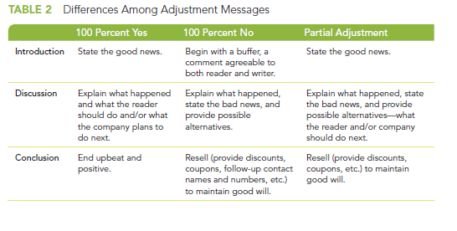

Slide 43
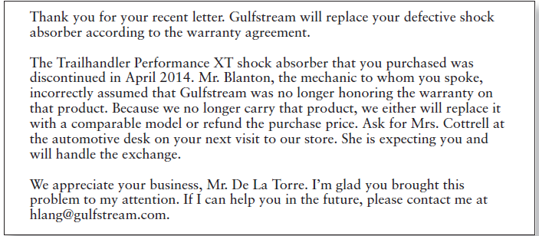

Slide 44
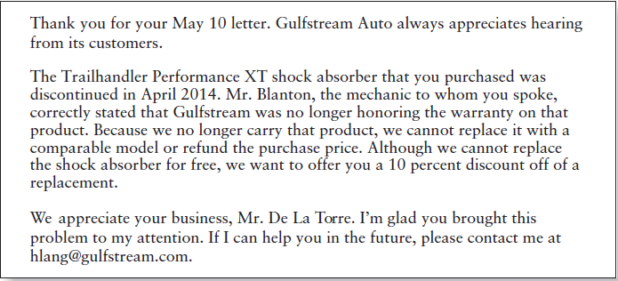

Slide 45
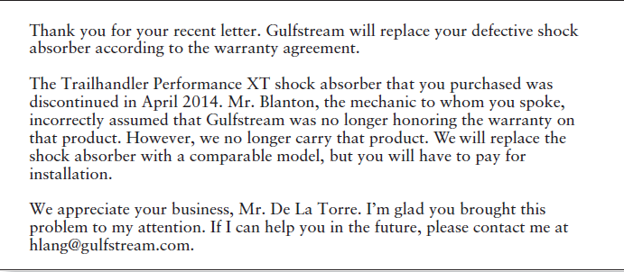

Slide 46
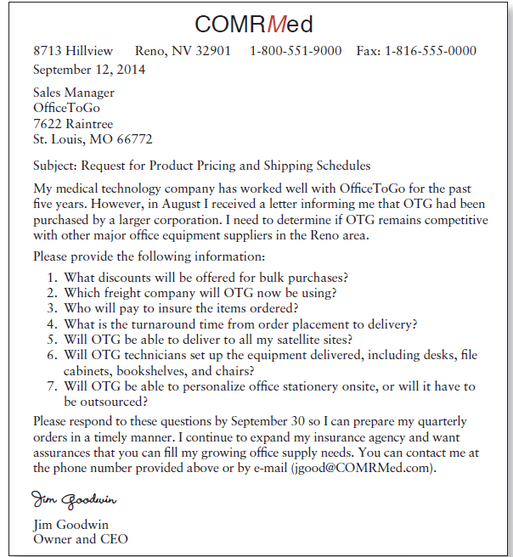
Letter of inquiry

Slide 47
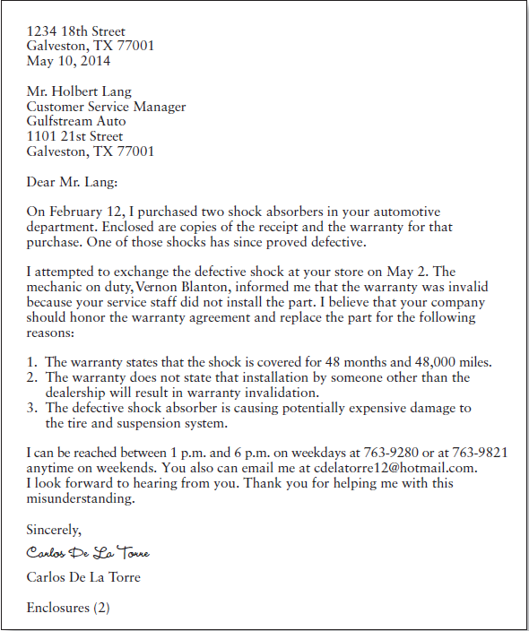
Letter of complaint

Slide 48
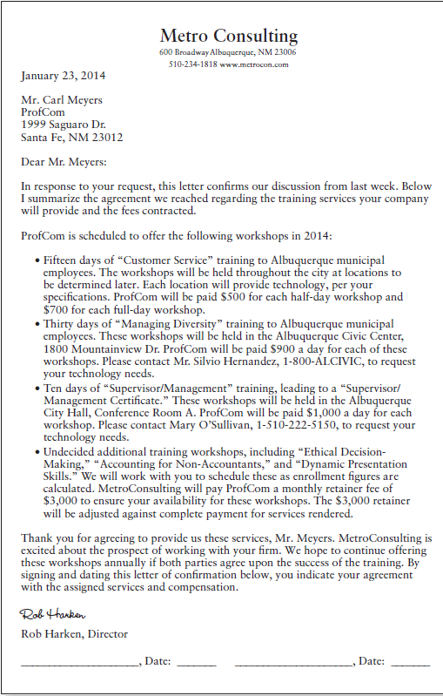
Letter of confirmation

Slide 49
Conclusion

